Slide 1

Ping Pong Game Development in C (SDL)
Mini project: a real-time 2-player Pong clone implemented in C using SDL for graphics and input. Clean, technical walkthrough for CS students — design, code, rendering, and collision mechanics.

Slide 2
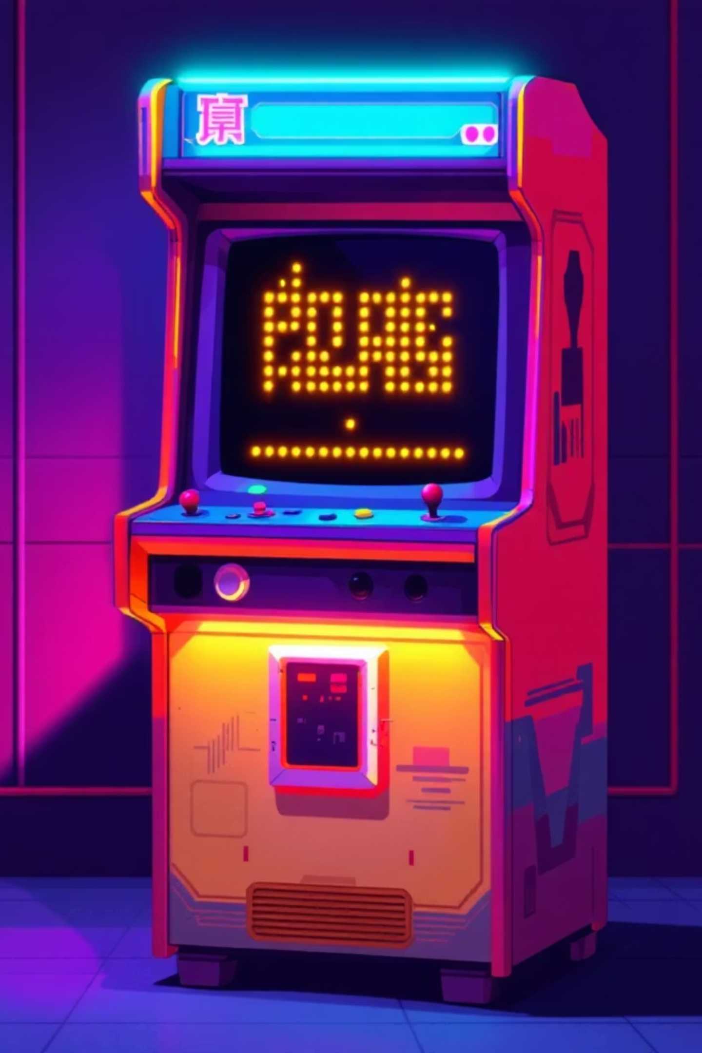
Introduction & Background
Inspiration
Project Goal
Learning Focus
Classic Pong (1970s): minimal rules and strong interaction loop — ideal for learning real-time systems.
Build a responsive 2D table-tennis simulation that demonstrates rendering, input handling and collision detection in C with SDL.
Animation timing, event-driven input, simple physics, and structured C program design.

Slide 3
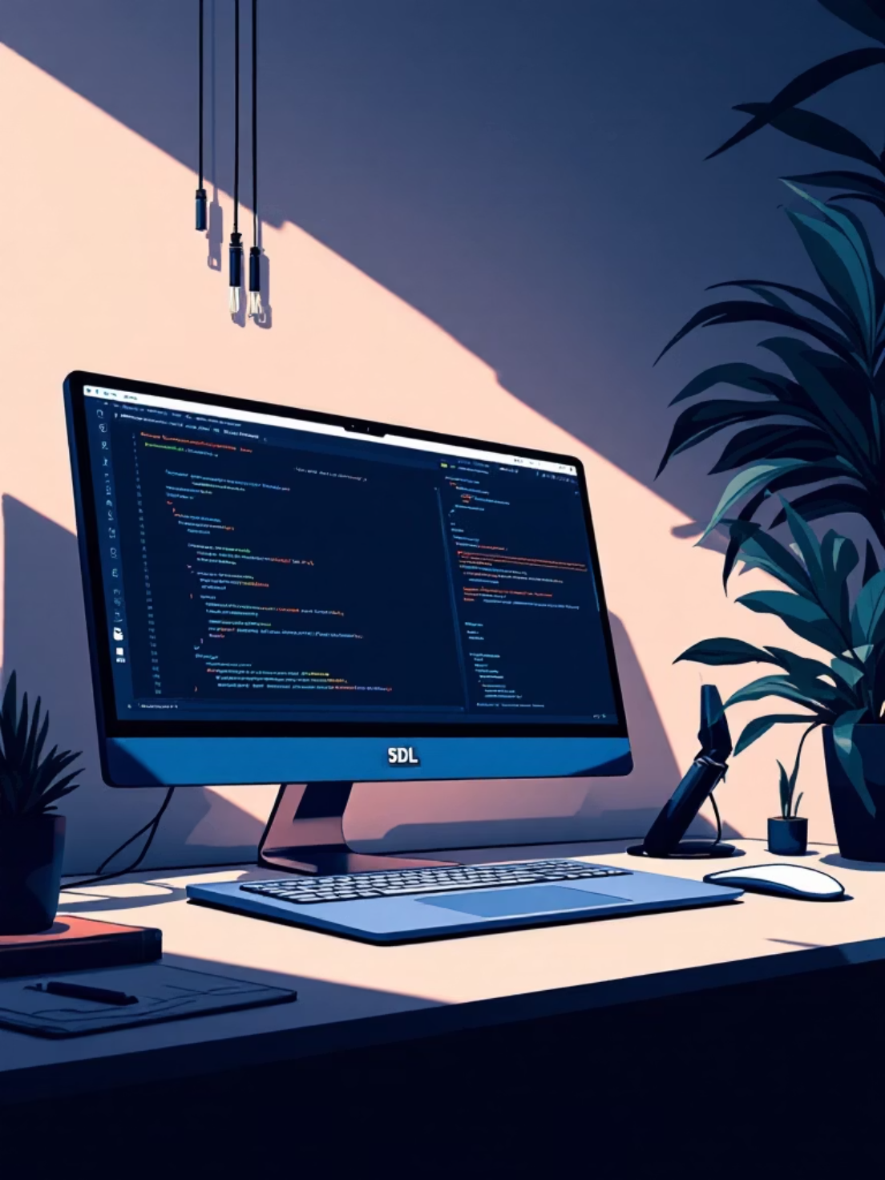
Technologies & Libraries
C (ISO C): core game logic, structs for entities, manual memory & state management.
SDL2: windowing, renderer, texture-less immediate mode drawing and event system.
Build tools: gcc/clang, makefile for compilation and linking with -lSDL2.
Testing: iterative runs, debug logging, frame-timing checks.

Slide 4
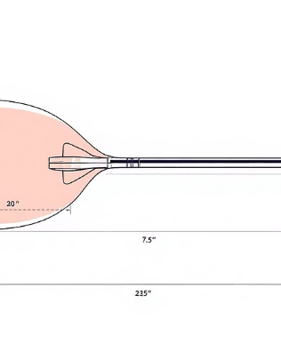
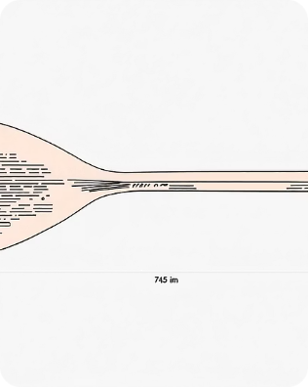
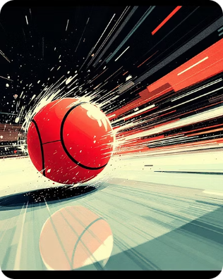
Screen Layout & Game Components
Left Paddle
Right Paddle
Ball
Circular head + rectangular handle. Controlled by W / S. Movement clamped to 0..480 screen height.
Same design; controlled by ↑ / ↓. Symmetric physics and collision bounds.
Radius considered in collision. Stores position, velocity (dx, dy) and speed scalar.

Slide 5
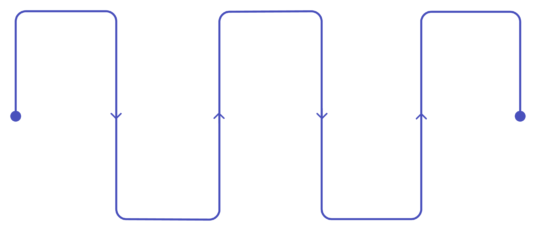
Program Structure
Initialize
Main Loop
Cleanup
Set up SDL and subsystems
Handle events, update, render
Free resources and quit SDL
Create Window
Detect Collisions
Create window and renderer
Resolve ball and paddle hits
The diagram shows the main lifecycle: setup, continuous loop with fixed timestep for updates, render, and graceful teardown. Use modular functions for clarity.

Slide 6


Graphics Rendering
Primitive Drawing
Custom filled-circle function using scanlines or midpoint algorithm; paddles built from circle + rect primitives.
Frame Flow
Clear background → draw centre dashed line → draw paddles and ball → SDL_RenderPresent()
Keep renderer in accelerated mode and use vsync for stable frame pacing during demos.

Slide 7

User Controls
Left Player
System Controls
W: Move paddle up
S: Move paddle down
ESC: Exit game
Continuous keyboard state read via SDL_GetKeyboardState for smooth motion
Right Player
Up Arrow: Move paddle up
Down Arrow: Move paddle down
Input handling uses event polling for discrete events and state queries for continuous movement.

Slide 8
Game Logic & Collision Detection
01
02
Ball Movement
Wall Collisions
Position updated: x += dx * dt, y += dy * dt. Speed scalar applied to dx/dy for easy difficulty tuning.
Top/bottom bounce: invert dy when ball.y - radius ≤ 0 or ball.y + radius ≥ screen_height.
03
04
Paddle Collisions
Miss & Reset
Check overlap against paddle circle head and rectangular handle. On collision: invert dx and optionally adjust dy based on hit offset.
If ball.x ± radius passes left/right bounds, increment score, reset ball to centre with initial velocity towards scorer.
Consider ball radius in all checks and clamp paddle positions to prevent sinking off-screen.

Slide 9
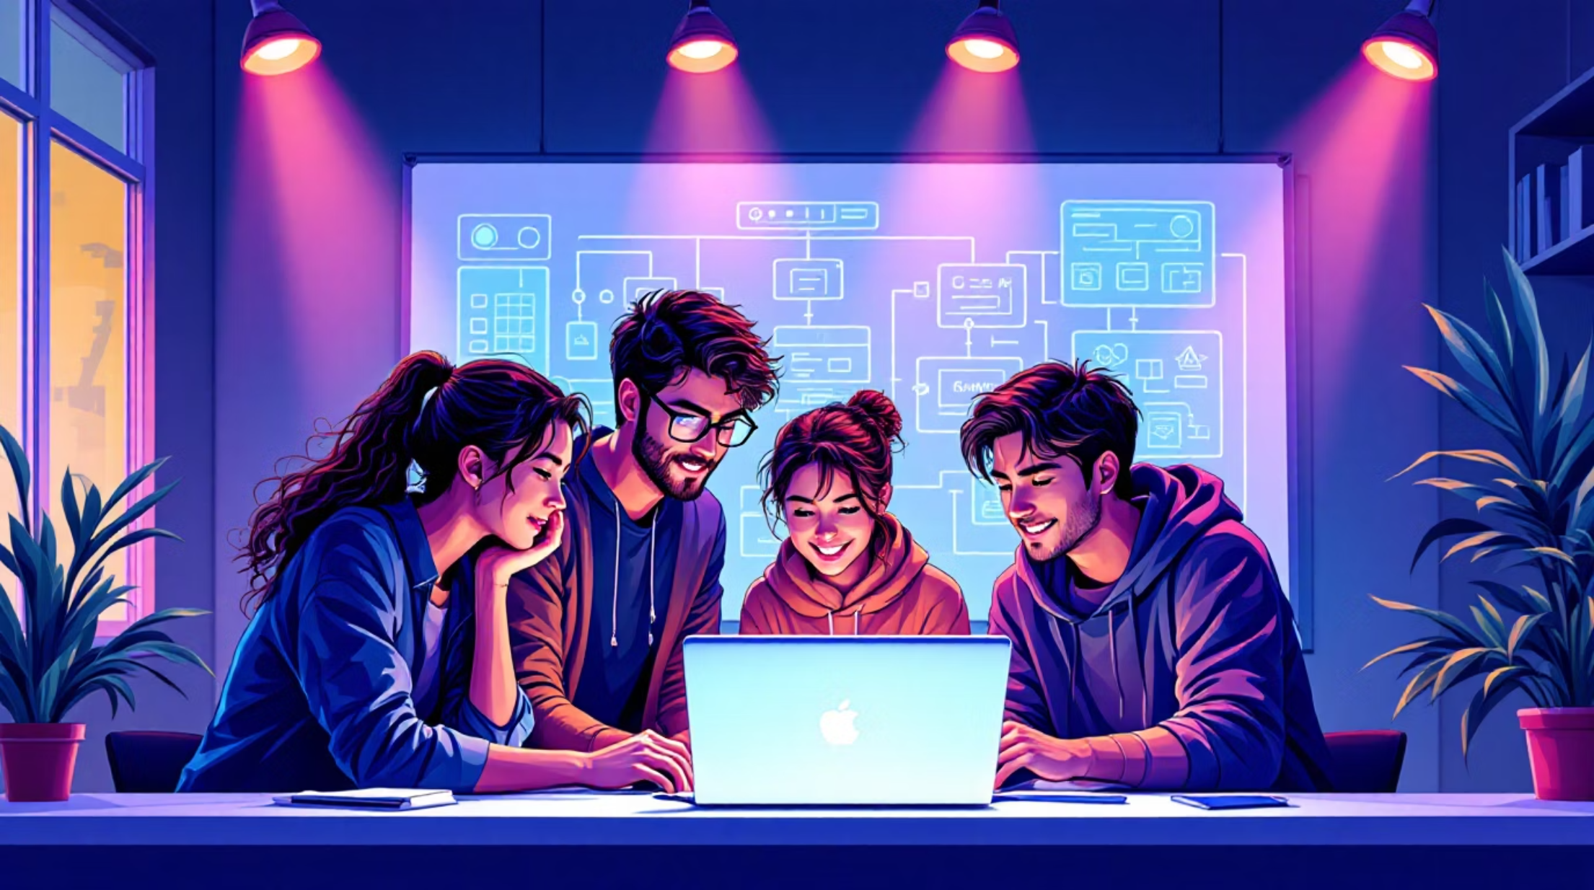

Educational Value
Demonstrates real-time programming and fixed/variable timestep trade-offs.
Introduces basic collision geometry and mitigation of tunnelling (simple fixes like conservative step or radius checks).
Reinforces modular C design: header files, clear function boundaries, resource lifecycle.
Future Scope
Score system, HUD and persistent high-scores
Sound via SDL_mixer, AI opponent with simple state machine
Network multiplayer or OpenGL-based enhanced rendering
Project is an excellent classroom demo: compact codebase, visible behaviour, and many extension opportunities for assignments.

Slide 10

Conclusion & Next Steps
1
2
3
Achievement
Key Takeaways
Action Items
Working 2-player Pong in C with SDL: rendering, input, collisions and stable loop implemented.
Add scoring, sound, AI and network play. Refactor for testability and performance profiling.
Real-time loops, primitive rendering, and collision maths are foundational for interactive systems.
Team: Sachin Kumar; Khushi Agrawal; Akshita Kamath; Anay Rudrawar; Akshat Agrawal; Nirjar Oza — ready to demo and extend.

Slide 11
OUR TEAM MEMBER
1.Sachine kumar(1262253593)
2.Akshita Kamath(1262253339)
3.Akshat Aggarwal(1262253946)
4.Khushi Agrawal(1262252749)
5.Nirjar Oza(1262251345)
6.Anay Rudrawar(1262252029)

